Slide 1


Microsoft Azure Azure Resource Manager czyli tworzenie środowisk z szablonu
Piotr Rogala

Slide 2


About Me
Current working in UNIT4
Blog: http://justcloud.pl/blog
FB Page: http://facebook.com/justcloudpl
Group leader:
Microsoft Azure User Group Poland
http://azureug.org

Slide 3
piotr@justcloud.pl

Slide 4

Wrocławska Grupa Microsoft Azure User Group Poland
https://www.meetup.com/Microsoft-Azure-Users-Group-Poland/
https://www.facebook.com/groups/azureugpl
http://azureug.org/

Slide 5
Agenda
Azure Resource Manager
Tamplete's
Tools for ARM
WorkShop
Deploy VM
Deploy VM + Tag's
Deploy VM + DSC
Deploy VM + Custom Script

Slide 6
GAB Workshop materials
http://gab2017.justcloud.pl

Slide 7
Azure Resource Manager
Rest API
Automation
Environment from scripts
Universal
Elastic
IaaC
https://azure.microsoft.com/en-us/documentation/articles/resource-group-overview/
Notes:
https://docs.microsoft.com/en-us/azure/azure-resource-manager/resource-group-authoring-templates

Slide 8
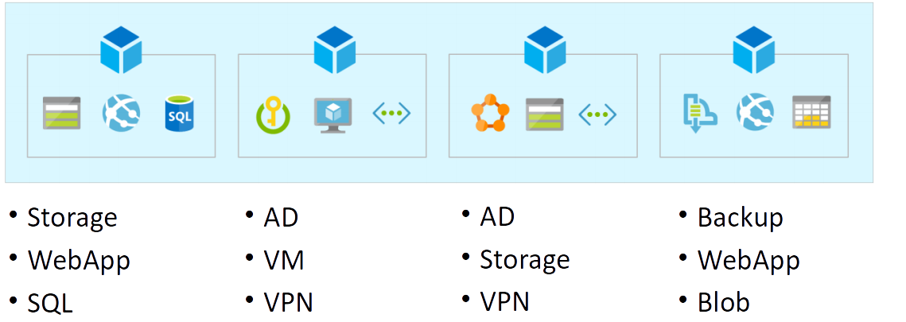
Azure Resource Group

Slide 9
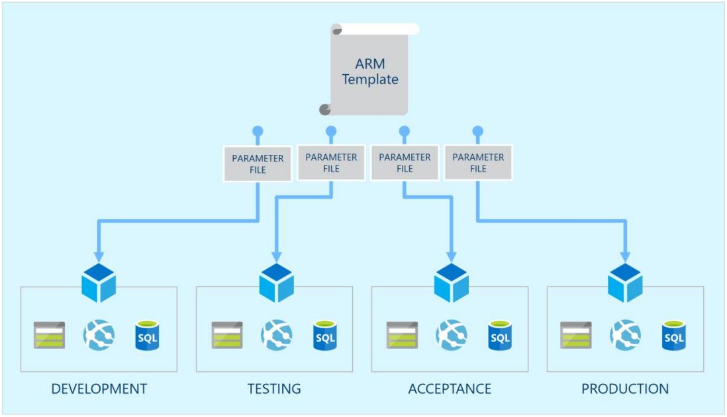

Slide 10
Documentation
https://docs.microsoft.com/en-us/rest/api/
Automation script in Azure Portal

Slide 11
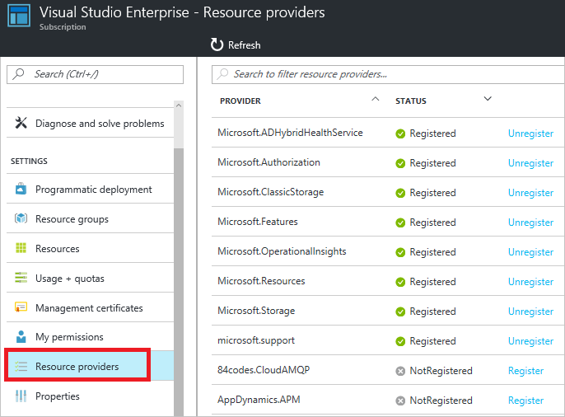
Providers
Powershell Get-AzureRmResourceProvider –ListAvailable
CLI az provider list

Slide 12
RBAC
Role-based access control
Role definitions
Role assignments
Roles:
Owner - can manage everything, including access
Contributor - can manage everything except access
Reader - can view everything, but can't make changes
User Access Administrator - can manage user access to Azure resources
Notes:
https://docs.microsoft.com/en-us/azure/active-directory/role-based-access-control-configure

Slide 13
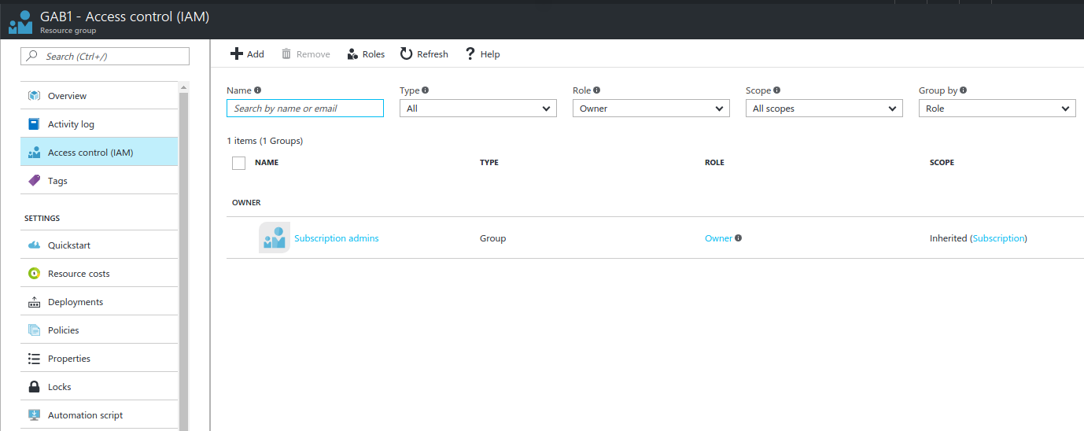
RBAC

Slide 14


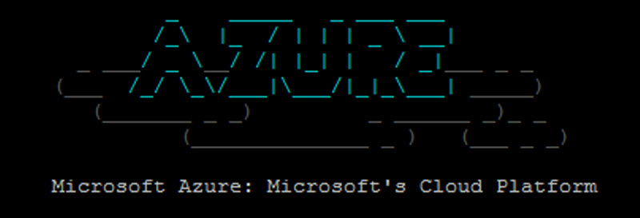
Tools for deployments
Visual Studio
PowerShell
CLI (cross-platform)
VSTS
Notes:
https://docs.microsoft.com/en-us/azure/azure-resource-manager/resource-group-template-deploy

Slide 15

Automation – Deploy .json
Prosta budowa skryptów do tworzenia zasobów w RG
Automatyzacja tworzenia środowisk
Uniwersalne rozwiązanie

Slide 16
.json
{
"$schema": "https://schema.management.azure.com/schemas/2015-01-01/deploymentTemplate.json#",
"contentVersion": "1.0.0.0",
"parameters" : {
},
"variables": {
},
"resources": [
],
"outputs":{
}
}

Slide 17
Przykładowy .json
FILE

Slide 18
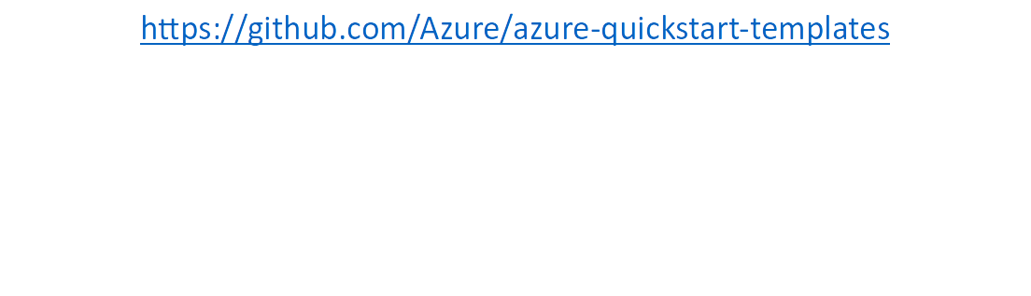
Gotowe szablony - .json

Slide 19
Deploy VM
Simple VM with Windows 2012

Slide 20
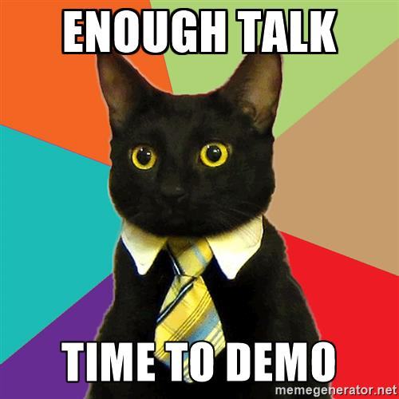
GAB1

Slide 21
Tag's
in parameters:
"tag": {"type": "gab"}
in resources:
{...
"tags": {
"displayName": "[concat(parameters('tag'),'-','PublicIPAddress')]" },
...}
Notes:
https://docs.microsoft.com/en-us/azure/azure-resource-manager/resource-group-using-tags

Slide 22

GAB2

Slide 23
DSC
https://gallery.technet.microsoft.com/scriptcenter/DSC-Resource-Kit-All-c449312d
https://github.com/Azure/azure-quickstart-templates/
Provider:
"publisher": "Microsoft.Powershell",
"type": "DSC",
"typeHandlerVersion": "2.19",
Notes:
https://docs.microsoft.com/en-us/azure/virtual-machines/windows/extensions-dsc-overview
https://mva.microsoft.com/en-US/training-courses/getting-started-with-powershell-desired-state-configuration-dsc--8672?l=YZHpImG1_7204984382

Slide 24

GAB3
DEMO

Slide 25
Custom Script Extension
Provider:
"publisher": "Microsoft.Compute",
"type": "CustomScriptExtension",
"typeHandlerVersion": "1.8",
Notes:
https://docs.microsoft.com/en-us/azure/virtual-machines/windows/extensions-customscript

Slide 26
GAB4
DEMO

Slide 27
Questions?
piotr@justcloud.pl
Podobała Ci się prezentacja? Napisz do mnie!

Slide 28
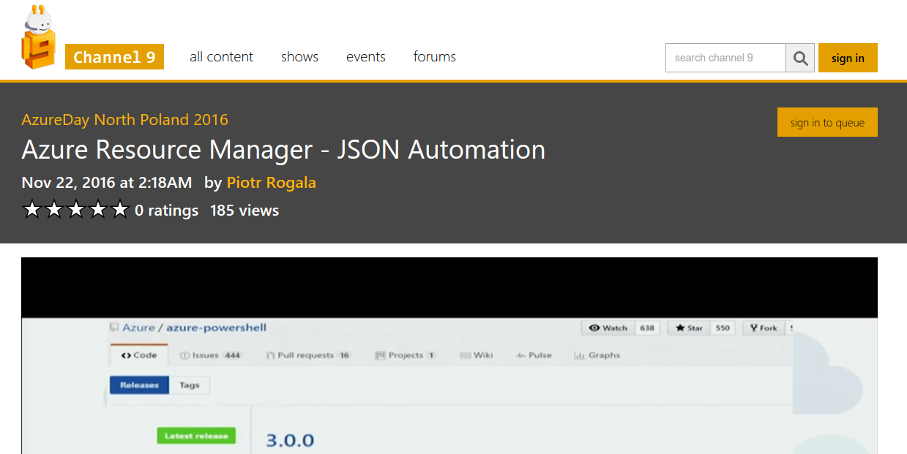
9channel – ARM json automation
http://justcloud.pl/blog/azure-resource-manager-json-automation/

